Slide 1
Welcome to Javascript

Slide 2
JavaScript Operators
An operator performs some operation on single or multiple operands and produces a result
<Left operand> operator <right operand>
For example, in 1 + 2,
+ sign is an operator and
1 is left side operand and
2 is right side operand
Types of Operators
Arithmetic Operators
Comparison Operators
Logical Operators
Assignment Operators
Conditional Operators or Ternary Operator

Slide 3
JavaScript Operators - Arithmetic
Operator | Description
+ | Adds two numeric operands.
- | Subtract right operand from left operand
* | Multiply two numeric operands.
/ | Divide left operand by right operand.
% | Modulus operator. Returns remainder of two operands.
++ | Increment operator. Increase operand value by one.
-- | Decrement operator. Decrease value by one.
Example: Arithmetic Operation
var x = 5, y = 10;
var z = x + y; //performs addition and returns 15
z = y - x; //performs subtraction and returns 5
z = x * y; //performs multiplication and returns 50
z = y / x; //performs division and returns 2
z = x % 2; //returns division remainder 1
var x = 5;
x++; //post-increment, x will be 5 here and 6 in the next line
++x; //pre-increment, x will be 7 here
x--; //post-decrement, x will be 7 here and 6 in the next line
--x; //pre-decrement, x will be 5 here

Slide 4
JavaScript Operators - Comparison
Operators | Description
== | Compares the equality of two operands without considering type.
=== | Compares equality of two operands with type.
!= | Compares inequality of two operands.
> | Returns a boolean value true if the left-side value is greater than the right-side value; otherwise, returns false.
< | Returns a boolean value true if the left-side value is less than the right-side value; otherwise, returns false.
>= | Returns a boolean value true if the left-side value is greater than or equal to the right-side value; otherwise, returns false.
<= | Returns a boolean value true if the left-side value is less than or equal to the right-side value; otherwise, returns false.
Example: Comparison Operators
var a = 5, b = 10, c = "5";
var x = a;
a == c; // returns true
a === c; // returns false
a == x; // returns true
a != b; // returns true
a > b; // returns false
a < b; // returns true
a >= b; // returns false
a <= b; // returns true

Slide 5
JavaScript Operators - Logical
Operator | Description
&& | && is known as AND operator. It checks whether two operands are non-zero or not (0, false, undefined, null or "" are considered as zero). It returns 1 if they are non-zero; otherwise, returns 0.
|| | || is known as OR operator. It checks whether any one of the two operands is non-zero or not (0, false, undefined, null or "" is considered as zero). It returns 1 if any one of of them is non-zero; otherwise, returns 0.
! | ! is known as NOT operator. It reverses the boolean result of the operand (or condition). !false returns true, and !true returns false.
Example: Logical Operators
var a = 5, b = 10;
(a != b) && (a < b); // returns true
(a > b) || (a == b); // returns false
(a < b) || (a == b); // returns true
!(a < b); // returns false
!(a > b); // returns true

Slide 6
JavaScript Operators - Ternary
JavaScript provides a special operator called ternary operator :? that assigns a value to a variable based on some condition.
Ternary operator ?: is a short form of if-else condition
Syntax:
<condition> ? <value1> : <value2>;
Example:
var a = 10, b = 5;
var c = a > b? a : b; // value of c would be 10
var d = a > b? b : a; // value of d would be 5

Slide 7
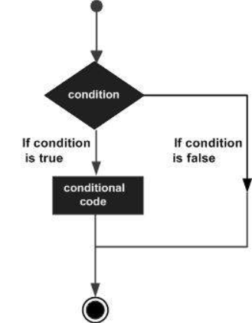
JavaScript conditional statements
JavaScript includes if-else conditional statements to control the program flow, similar to other programming languages.
if condition
if-else condition
else if condition

Slide 8
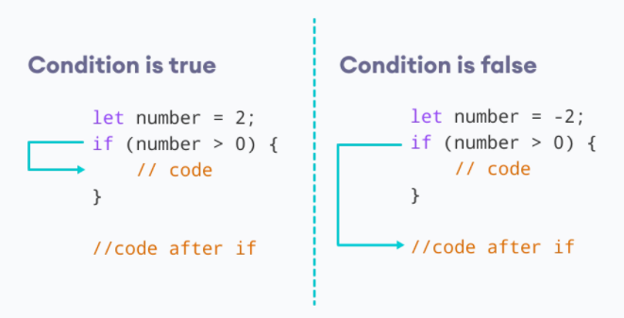
Conditional statements – if condition
The keyword if tells JavaScript to start the conditional statement.
(1 > 0) is the condition to test, which in this case is true — 1 is greater than 0.
The part contained inside curly braces {} is the block of code to run.
Because the condition passes, the variable outcome is assigned the value "if block".
Syntax:
if(condition expression)
{
// code to be executed if condition is true
}
Example:
if( 1 > 0)
{
alert("1 is greater than 0");
}
if( 1 < 0)
{
alert("1 is less than 0");
}

Slide 9
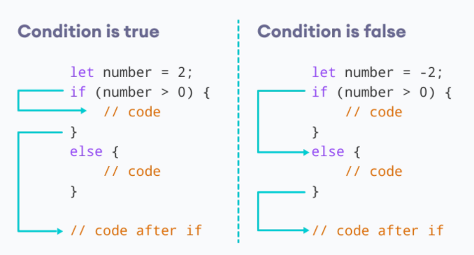
Conditional statements - Else condition
Use else statement when you want to execute the code every time when if condition evaluates to false.
Syntax:
if(condition expression)
{
// block of code to be executed if the condition is true}
else{
// block of code to be executed if the condition is false
}
Example:
let num = 2
// let num = -2
if(number > 0)
{
alert(num +” is greater than 0”);
}
else
{
alert(num +” is less than 0”);
}

Slide 10
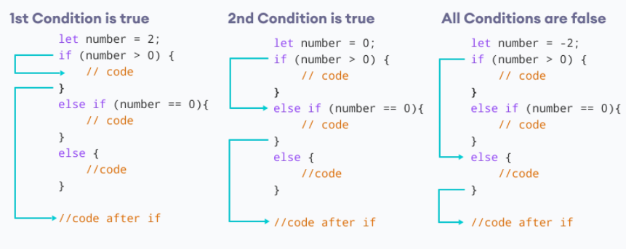
Conditional statements – Else if condition
Use "else if" condition when you want to apply second level condition after if statement
Syntax:
if(condition expression)
{
//Execute this code block
}
else if(condition expression){
//Execute this code block
}
Example:
// check if the number if positive, negative or zero
let number = 2;
number is positive");
} if (number > 0) {
console.log("The
else if (number == 0) {
console.log("The number is 0");
}
else {
console.log("The number is negative");
}

Slide 11
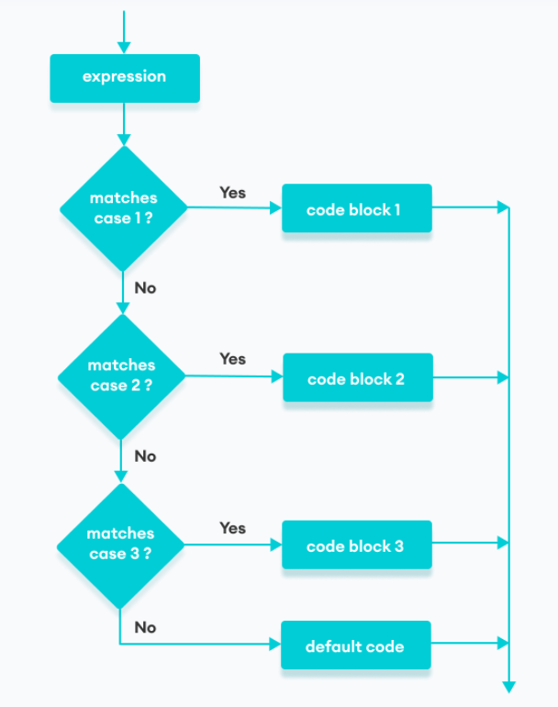
JavaScript conditional statements - Switch
The JavaScript switch statement is used in decision making.
The switch statement evaluates an expression and executes the corresponding body that matches the expression's result.
Syntax:
switch(expression or literal value){
case 1:
//code to be executed
break;
case 2:
//code to be executed
break;
case n:
//code to be executed
break;
default:
//default code to be executed
//if none of the above case executed
}

Slide 12
JavaScript conditional statements - Switch
Example:
let a = 2;
switch (a) {
case 1:
a = 'one';
break;
case 2:
a = 'two';
break;
default:
a = 'not found';
break;
}
console.log(`The value is ‘+{a});
Example:
let str = "bill";
switch (str)
{
case "steve":
alert("This is Steve");
case "bill":
alert("This is Bill");
break;
case "john":
alert("This is John");
break;
default:
alert("Unknown Person");
break;
}

